Slide 1


Rutgers Data Science Bootcamp
Cryptocurrency
Project
Sandra Regan/Matt Beneventi/Hua Wu/Carlos Hurtado/Emily Coffield
November 10th, 2 0 1 8

Slide 2





Motivation Summary
Hypothesis : The frequency of news drives the price of crypto currencies. News impacts investor confidence.
Question: Can we make good investment decision based on how much a crypto is mentioned in the news? We chose this question because the price of currency does not appear to be driven by typical market conditions.
Overall the observations we made were encouraging. We were able to see a correlation between price and news count. However we could not prove causality.

Slide 3


Questions
We were predominantly asking ourselves about:
How often is crypto talked about in social media or in the news?
What are the top Crypto currencies based on market capital?
What is the price and volume history for those cryptos?
Kinds of data needed to answer the questions:
News and story counts – *Bloomberg /Google Trends
Crypto Market Capital – Data Scrapping from Coin Market Cap
Historical Crypto price and volume - Data Scrapping from Coin Market Cap

Slide 4
Data Cleanup
Data Exploration & Cleanup:
News and Story Counts: Limitations in getting data
News API only had 1 month of data
Twitter API Key was hard to get
Google Trends did not have an API
Data Insights:
We attempted to get more information on the specific news sources behind Bloomberg News counts. When we asked Bloomberg support what the feedback was, they could not disclose exact sources. Generally speaking, it is both Bloomberg and external sources but they cannot identify or disclose the sources.
Problems:
Combining data sources was tricky due to differences in date type. We were able to convert the values to DateTime using Pandas functions.

Slide 5
Data Analysis
Determined top 5 crypto currencies
Analyzed news count data of the top currencies
Merged the data to combine the price and news count over 2 year period
Charted the correlation between the news counts and price
Calculated the correlation coefficient to support the data visualization
Assessed volatility by calculating the daily percent change in closing price
Determined if we could prove causality by running regression tests on each currency and its respective news mention count.
Statistical analysis of crypto activity to look for trends in price this was done using a histogram
Calculated the standard deviation
Used a time series graph to visualize the weekly standard deviation over two years

Slide 6
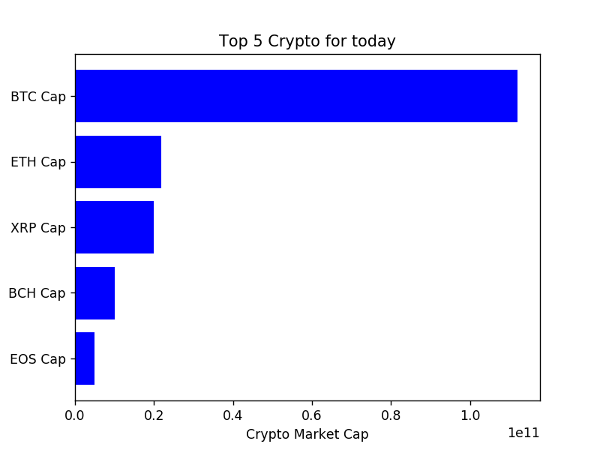
Choosing The Top Crypto
Top 5 based on Market Cap

Slide 7
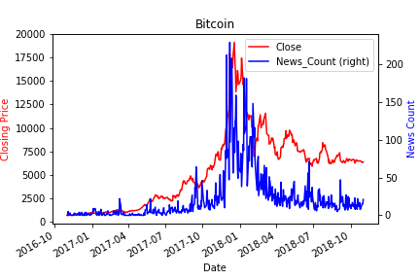
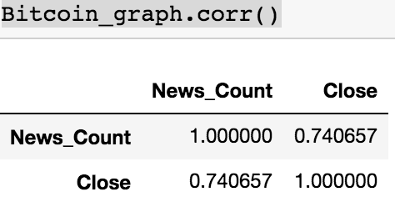
Correlation - Price & Mentions
Bitcoin closing prices & daily news count
Question: Is there a correlation between crypto price and the number of times a currency is mentioned in the news?
We were looking for a strong correlation between news count and price. The data visualization presents an apparent correlation between the two variables . This was consistent for 4 out of the 5 currencies, EOS was the outlier.
Notes:
Matt to fill in text

Slide 8
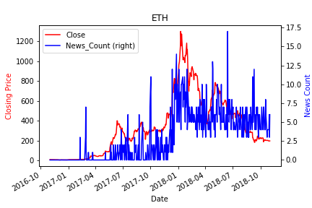
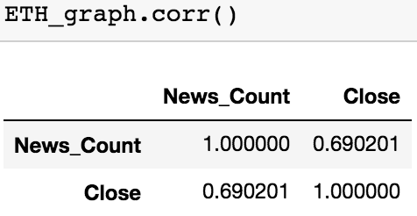
Correlation - Price & Mentions
ETH closing prices & daily news count

Slide 9
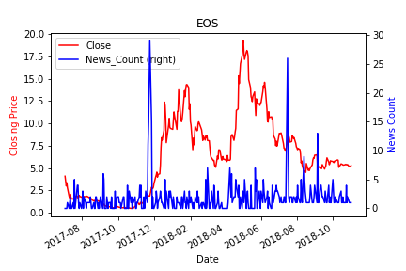
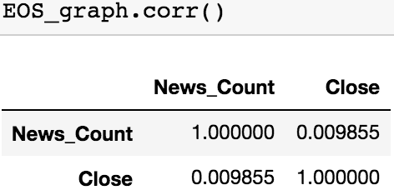
Correlation - Price & Mentions
EOS closing prices & daily news count

Slide 10
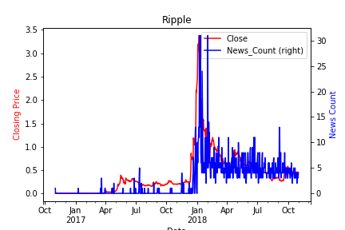
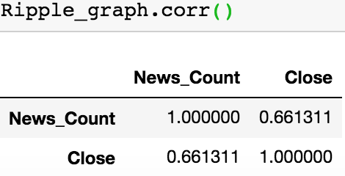
Correlation - Price & Mentions
Ripple closing prices & daily news count
Notes:
Emily to pull in all 5 crypto correlation slides

Slide 11
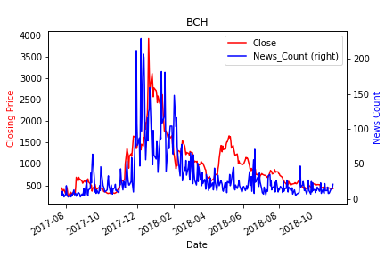
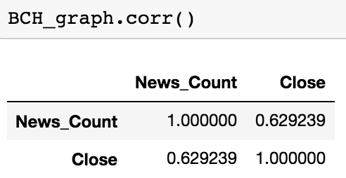
Correlation - Price & Mentions
BCH closing prices & daily news count
Notes:
Emi

Slide 12
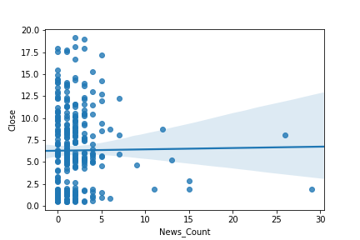
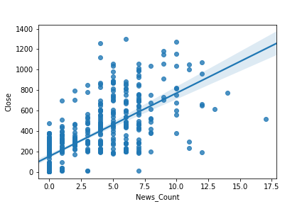
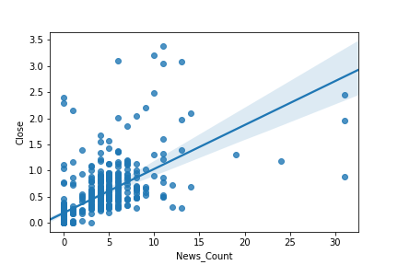
Regression Analysis
EOS
Question: Do these trend lines for news count and price correlate to each other?
In all cases except for EOS the correlation was positive and therefore suggests that there is a correlation
Etherum
Ripple

Slide 13
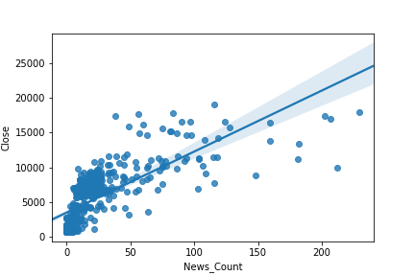
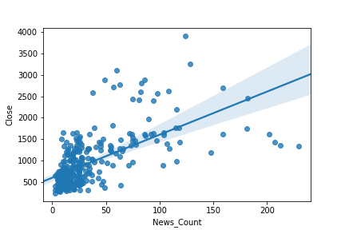
Regression Analysis
We wanted to prove if the news cycle caused a change in price.
Bitcoin
BCH

Slide 14
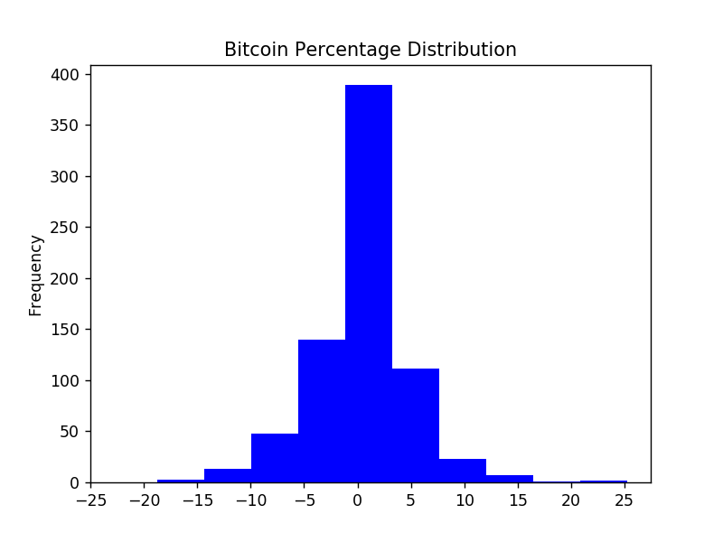
Trade Frequency Analysis
Question: What trends can we identify via the various cryptos?
Percentage distribution frequency chart.
This gives us a range between the negative and positive trading days in the crypto market. We will measure the standard deviation, which we measured on a 2 year time period on the percentage of change. It is going to be 4.695, which means that most of the trading within crypto occurs between + 4.695 and - 4.695. Thus, anything above or below this range should be considered significant.
Illustrating the top 10 days of news count versus the percentage change in the closing price of the top 5 crypto currencies.

Slide 15
Regression Analysis
Do story counts change price?
Based on the R Square and P and F found in the regression analysis we can conclude that news mentions cannot be used to predict the price of a currency.

Slide 16
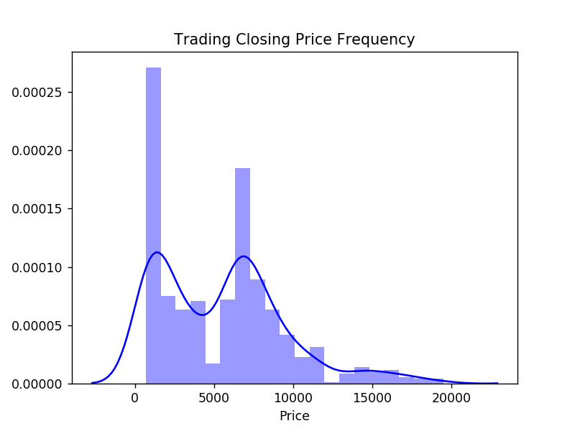
Trading Frequency Levels

Slide 17
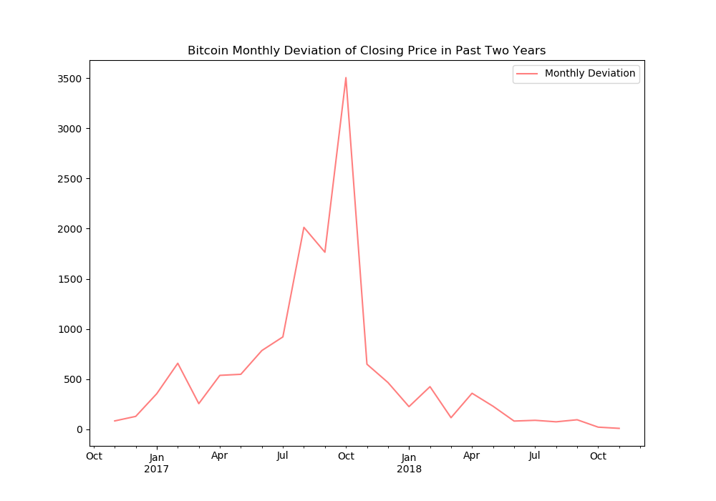
Bitcoin Closing Price Standard Deviation

Slide 18



Discussion & Post Mortem
We found a correlation between the news count and prices. The two variables appeared to follow the same trend. We could not conclude if the news drove price or if price drove news. Our regression analysis showed that less than 1 percent of the change in price could be attributed to the news count.

Slide 19


Thanks!
Question & Answer Session.

